Slide 1
European economic regulation law
Topic 3 –Network industries and EU sectoral policies

Slide 2
Preliminaries considerations
Definition of EU policy / vs internal market and competition rules
Diversity of EU policies concerned: overview of the diversity of policies overlapping with network issues
Transport policy
Network policy
Industry policy
Energy policy
- Legal issues of interferences between EU policies and competition rules

Slide 3
I – Energy policy I. A. Legal base and principles: art. 194 TFUE
1. In the context of the establishment and functioning of the internal market and with regard for the need to preserve and improve the environment, Union policy on energy shall aim, in a spirit of solidarity between Member States, to:
(a) ensure the functioning of the energy market;
(b) ensure security of energy supply in the Union;
(c) promote energy efficiency and energy saving and the development of new and renewable forms of energy; and
(d) promote the interconnection of energy networks.
2. Without prejudice to the application of other provisions of the Treaties, the European Parliament and the Council, acting in accordance with the ordinary legislative procedure, shall establish the measures necessary to achieve the objectives in paragraph 1. Such measures shall be adopted after consultation of the Economic and Social Committee and the Committee of the Regions.

Slide 4
I – Energy policy I. A. Legal base and principles : - Principle of solidarity in the field of energy
CJUE, 15 July 2021, Germany c. Poland and Commission, case C-848/19 P
In addition to Article 194(1) TFEU, several other provisions of the Treaties refer to the principle of solidarity. As regards the EU Treaty, in the preamble thereto, the Member States declare that, by establishing the European Union, they intend ‘to deepen the solidarity between their peoples’. Solidarity is also mentioned in Article 2 TEU, as one of the characteristics of a society founded on the values common to the Member States, and in the third subparagraph of Article 3(3) TEU, according to which the European Union is to promote, inter alia, solidarity among Member States. In accordance with Article 21(1) TEU, solidarity is also one of the principles governing the European Union’s external action and, under Article 24(2) and (3) TEU, it is among the provisions relating to the common foreign and security policy as ‘mutual political solidarity’ among Member States.
40 In the case of the FEU Treaty, Article 67(2) expressly refers to solidarity between Member States in matters of asylum, immigration and external border controls, and the application of that principle in that area is confirmed in Article 80 TFEU. In Title VIII of Part Three of the FEU Treaty, specifically in Chapter 1 which covers economic policy, Article 122(1) TFEU also refers explicitly to the spirit of solidarity between Member States, which additionally features in Article 222 TFEU, according to which the European Union and its Member States are to act jointly in a spirit of solidarity where a Member State is the object of a terrorist attack or the victim of a disaster.
41 It follows that, as the General Court correctly noted in paragraph 69 of the judgment under appeal, the principle of solidarity underpins the entire legal system of the European Union (see, to that effect, judgments of 7 February 1973, Commission v Italy, 39/72, EU:C:1973:13, paragraph 25, and of 7 February 1979, Commission v United Kingdom, 128/78, EU:C:1979:32, paragraph 12) and it is closely linked to the principle of sincere cooperation, laid down in Article 4(3) TEU, pursuant to which the European Union and the Member States are, in full mutual respect, to assist each other in carrying out tasks which flow from the Treaties. In that regard, the Court has held, inter alia, that that principle not only obliges the Member States to take all the measures necessary to guarantee the application and effectiveness of EU law but also imposes on the EU institutions mutual duties to cooperate in good faith with the Member States (judgment of 8 October 2020, Union des industries de la protection des plantes, C‑514/19, EU:C:2020:803, paragraph 49 and the case-law cited).
42 As regards the allegedly abstract nature of the principle of solidarity, invoked by the Federal Republic of Germany in order to argue that it cannot be used in the context of judicial review of the legality of Commission acts, it must be pointed out that the Court, as the Advocate General noted in point 69 of his Opinion, expressly referred to the principle of solidarity mentioned in Article 80 TFEU in coming to the conclusion that, in essence, Member States had failed to fulfil certain of their obligations under EU law on border controls, asylum and immigration (judgments of 6 September 2017, Slovakia and Hungary v Council, C‑643/15 and C‑647/15, EU:C:2017:631, paragraph 291, and of 2 April 2020, Commission v Poland, Hungary and Czech Republic (Temporary mechanism for the relocation of applicants for international protection), C‑715/17, C‑718/17 and C‑719/17, EU:C:2020:257, paragraphs 80 and 181).

Slide 5
I.B. Main dimensions
The current policy agenda is driven by energy security concerns and by the alignment of the EU energy and climate targets, as proposed in July 2021 in the ‘Fit For 55’ package, including:
A reduction of at least 55% in greenhouse gas emissions compared to 1990 levels by 2030;
A reduction to net zero greenhouse gas emissions by 2050.
The current energy targets for 2030, agreed in October 2014 and revised in December 2018, are:
An increase to 32% of the share of renewable energies in energy consumption;
An improvement of 32.5% in energy efficiency;
The interconnection of at least 15% of the EU’s electricity systems.
The new proposed EU energy targets for 2030, informally agreed in March 2023, include:
An increase of the share of renewable energies in energy consumption to 42.5%, with the aim ofachieving 45%;
A reduction of 11.7% for the EU primary and final energy consumption, compared to the 2020 projections for 2030, equivalent to 40.5% and 38% respectively compared to the 2007 projections.
The current European energy policy is based on the Energy Union strategy (COM/2015/80) published in February 2015, which aimed at building an energy union to give EU households and businesses a secure, sustainable, competitive and affordable energy supply.

Slide 6
I.B. Main dimensions
Green Deal : revision of all EU acts on climate and energy, including : - the Renewable Energy Directive (COM/2021/557)
the Energy Efficiency Directive (COM/2021/558)
the Energy Taxation Directive (COM/2021/563)
the Energy Performance of Buildings Directive (COM/2021/802)
the Gas Directive (COM/2021/803) and Regulation (COM/2021/804).

Slide 7
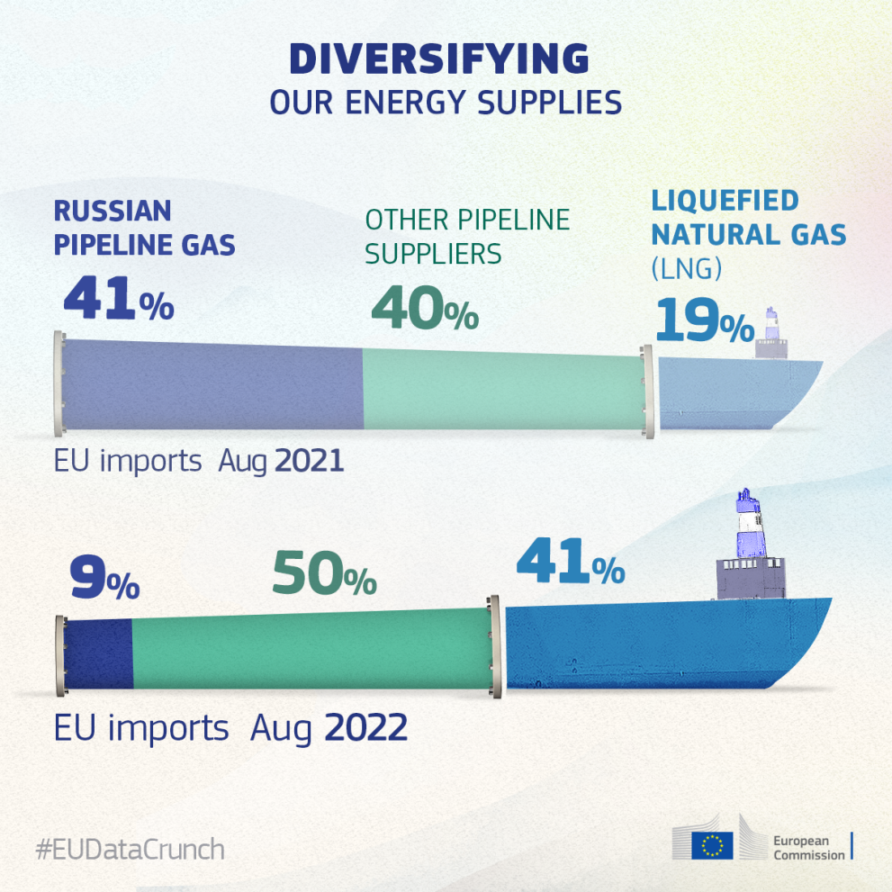
I.C. Issues of strategic autonomy: RePower Plan (COMMUNICATION FROM THE COMMISSION TO THE EUROPEAN PARLIAMENT, THE EUROPEAN COUNCIL, THE COUNCIL, THE EUROPEAN ECONOMIC AND SOCIAL COMMITTEE AND THE COMMITTEE OF THE REGIONS REPowerEU Plan, COM/2022/230 final )
Origin of Gas

Slide 8
II – Transport policy
II.A Legal basis in primary law
Article 90 (ex Article 70 TEC)
The objectives of the Treaties shall, in matters governed by this Title, be pursued within the framework of a common transport policy.
Article 91 (ex Article 71 TEC)
1. For the purpose of implementing Article 90, and taking into account the distinctive features of transport, the European Parliament and the Council shall, acting in accordance with the ordinary legislative procedure and after consulting the Economic and Social Committee and the Committee of the Regions, lay down:
(a) common rules applicable to international transport to or from the territory of a Member State or passing across the territory of one or more Member States;
(b) the conditions under which non-resident carriers may operate transport services within a Member State;
(c) measures to improve transport safety;
(d) any other appropriate provisions.
2. When the measures referred to in paragraph 1 are adopted, account shall be taken of cases where their application might seriously affect the standard of living and level of employment in certain regions, and the operation of transport facilities.
Article 93 - (ex Article 73 TEC)
Aids shall be compatible with the Treaties if they meet the needs of coordination of transport or if they represent reimbursement for the discharge of certain obligations inherent in the concept of a public service

Slide 9
II.B. Articulation btw transport law and internal market Case Uber (CJUE, 20 th december 2017, Asociación Profesional Elite Taxi c. Uber Systems SpainSL, aff. C-434/15)
Asociación Profesional Elite Taxi (‘Elite Taxi’) is a professional organisation representing taxi drivers in the city of Barcelona (Spain). On 29 October 2014, Elite Taxi brought an action before the Juzgado de lo Mercantil No 3 de Barcelona (Commercial Court No 3 of Barcelona, Spain) asking the court, inter alia, to make an order against Uber Systems Spain SL (‘Uber Spain’), a company governed by Spanish law;
to declare that its activities, which allegedly infringe the legislation in force and amount to misleading practices, are acts of unfair competition; to order it to cease its unfair conduct consisting of supporting other companies in the group by providing on-demand booking services by means of mobile devices and the internet, when that is directly or indirectly linked to use of the digital platform Uber in Spain; and to prohibit it from engaging in such activities in the future. According to the referring Court’s findings, neither Uber Spain nor the owners or drivers of the vehicles concerned have the licences and authorisations required under the Regulation on taxi services in the metropolitan area of Barcelona.

Slide 10
Within the identification of the legal nature of that activity, can it be considered to be … in part an information society service, and, if so, ought the electronic intermediary service to benefit from the principle of freedom to provide services as guaranteed in [EU] legislation — Article 56 TFEU and Directives [2006/123] and … [2000/31]?
(3) If the service provided by [Uber Spain] were not to be considered to be a transport service and were therefore considered to fall within the cases covered by Directive 2006/123, is Article 15 of the Law on Unfair competition — concerning the infringement of rules governing competitive activity — contrary to Directive 2006/123, specifically Article 9 on freedom of establishment and authorisation schemes, when the reference to national laws or legal provisions is made without taking into account the fact that the scheme for obtaining licences, authorisations and permits may not be in any way restrictive or disproportionate, that is, it may not unreasonably impede the principle of freedom of establishment?

Slide 11
That intermediation service must thus be regarded as forming an integral part of an overall service whose main component is a transport service and, accordingly, must be classified not as ‘an information society service’ within the meaning of Article 1(2) of Directive 98/34, to which Article 2(a) of Directive 2000/31 refers, but as ‘a service in the field of transport’ within the meaning of Article 2(2)(d) of Directive 2006/123.
41 That classification is indeed confirmed by the case-law of the Court, according to which the concept of ‘services in the field of transport’ includes not only transport services in themselves but also any service inherently linked to any physical act of moving persons or goods from one place to another by means of transport (see, to that effect, judgment of 15 October 2015, Grupo Itevelesa and Others, C‑168/14, EU:C:2015:685, paragraphs 45 and 46, and Opinion 2/15 (Free Trade Agreement with Singapore) of 16 May 2017, EU:C:2017:376, paragraph 61).
42 Consequently, Directive 2000/31 does not apply to an intermediation service such as that at issue in the main proceedings.
43 Such service, in so far as it is classified as ‘a service in the field of transport’, does not come under Directive 2006/123 either, since this type of service is expressly excluded from the scope of the directive pursuant to Article 2(2)(d) thereof.
44 Moreover, since the intermediation service at issue in the main proceedings is to be classified as ‘a service in the field of transport’, it is covered not by Article 56 TFEU on the freedom to provide services in general but by Article 58(1) TFEU, a specific provision according to which ‘freedom to provide services in the field of transport shall be governed by the provisions of the Title relating to transport’ (see, to that effect, judgment of 22 December 2010, Yellow Cab Verkehrsbetrieb, C‑338/09, EU:C:2010:814, paragraph 29 and the case-law cited).
45 Accordingly, application of the principle governing freedom to provide services must be achieved, according to the FEU Treaty, by implementing the common transport policy (judgment of 22 December 2010, Yellow Cab Verkehrsbetrieb, C‑338/09, EU:C:2010:814, paragraph 30 and the case-law cited).
46 However, it should be noted that non-public urban transport services and services that are inherently linked to those services, such as the intermediation service at issue in the main proceedings, has not given rise to the adoption by the European Parliament and the Council of the European Union of common rules or other measures based on Article 91(1) TFEU.
47 It follows that, as EU law currently stands, it is for the Member States to regulate the conditions under which intermediation services such as that at issue in the main proceedings are to be provided in conformity with the general rules of the FEU Treaty.

Slide 12
§3 – Current issues in the context of green deal

Slide 13
III - EU Networks II.A Legal base
Article 170 TFEU - Trans-European Networks
1. To help achieve the objectives referred to in Articles 26 and 174 and to enable citizens of the Union, economic operators and regional and local communities to derive full benefit from the setting-up of an area without internal frontiers, the Union shall contribute to the establishment and development of trans-European networks in the areas of transport, telecommunications and energy infrastructures.
2. Within the framework of a system of open and competitive markets, action by the Union shall aim at promoting the interconnection and interoperability of national networks as well as access to such networks. It shall take account in particular of the need to link island, landlocked and peripheral regions with the central regions of the Union.

Slide 14
II - EU Networks II.Objectives
Regulation (EU) No 1315/2013 of the European Parliament and of the Council of 11 December 2013 on Union guidelines for the development of the trans-European transport network and repealing Decision No 661/2010/EU Text with EEA relevance
1. This Regulation establishes guidelines for the development of a trans-European transport network comprising a dual-layer structure consisting of the comprehensive network and of the core network, the latter being established on the basis of the comprehensive network.
2. This Regulation identifies projects of common interest and specifies the requirements to be complied with for the management of the infrastructure of the trans-European transport network.
3. This Regulation sets out the priorities for the development of the trans-European transport network.
4. This Regulation provides for measures for the implementation of the trans-European transport network. The implementation of projects of common interest depends on their degree of maturity, the compliance with Union and national legal procedures, and the availability of financial resources, without prejudging the financial commitment of a Member State or of the Union.

Slide 15
III - EU Networks II.Objectives
TEN-T comprises two network ‘layers’:
- The Core Network includes the most important connections, linking the most important nodes, and is to be completed by 2030.
- The Comprehensive Network covers all European regions and is to be completed by 2050.
TEN-TAtlantic
Baltic Adriatic
Mediterranean
North Sea-Baltic
North Sea-Mediterranean
Orient - East Med
Rhine-Alpine
Rhine-Danube
Scandinavian-Mediterranean

Slide 16
II - EU Networks III.Legal Issues related to network : CJUE, 12 nov. 2015, UK c. Europeal Parliamant and Council, aff. C-121/14 (appraising of the criteria of “project of common interest”
In accordance with the objective of contributing to the establishment and development of trans-European networks in the area of transport infrastructure, referred to in Article 170(1) TFEU, it is apparent from recital 8 in the preamble to that regulation that the trans-European transport network must be developed through the creation of new transport infrastructure, through the rehabilitation and upgrading of existing infrastructure and through measures promoting its resource-efficient use.
While it is true that a measure does not have to create a new transport infrastructure in order to be recognised as a project of common interest, such a project must none the less involve investment which, at the very least, is intended to rehabilitate or upgrade an existing infrastructure with a view to making it more efficient and effective, as is apparent in particular from Article 7 of Regulation No 1315/2013.
Lastly, it is evident from Article 48(1) of Regulation No 1315/2013, which merely refers to ‘[a]dequate coordination ... between the core network corridors and the rail freight corridors’, that, when exercising the power conferred on them by Article 171(1) TFEU and the first paragraph of Article 172 TFEU, the Parliament and the Council took the view that the rail freight corridors did not fall within the projects of common interest identified by that regulation.
In those circumstances, the United Kingdom cannot, therefore, claim that a project of common interest was established by the contested provisions.
In particular, Regulation No 913/2010 does not, even as regards existing rail freight corridors, provide for them to be developed as infrastructure projects. Economic operators have a number of management tools for these corridors so that they can use the railway lines concerned with greater efficiency and thus improve the operation of rail transport. The establishment of such corridors is thus intended to ensure better traffic coordination on the designated railway lines, in accordance with the management principles set out in Regulation No 913/2010.

Slide 17
IV– EU industrial policy II.Objectives and legal base
Article 173 TFUE - Industry
1. The Union and the Member States shall ensure that the conditions necessary for the competitiveness of the Union's industry exist.
For that purpose, in accordance with a system of open and competitive markets, their action shall be aimed at:
- speeding up the adjustment of industry to structural changes,
- encouraging an environment favourable to initiative and to the development of undertakings throughout the Union, particularly small and medium-sized undertakings,
- encouraging an environment favourable to cooperation between undertakings,
- fostering better exploitation of the industrial potential of policies of innovation, research and technological development.

Slide 18
III – EU industrial policy II.Objectives and legal base
The instruments of the EU’s industrial policy, which are also those of enterprise policy, aim to create the general conditions in which entrepreneurs and businesses can take initiatives and exploit their ideas and opportunities.
Nonetheless, industrial policy should take into account the specific needs and characteristics of individual sectors. The annual European Competitiveness Reports analyse the strengths and weaknesses of the EU’s economy in general and its industry in particular, and may trigger cross-sectoral or sectoral policy initiatives.

Slide 19
III – EU industrial policy II.Encompassing objective: COM(2020) 102 final, COMMUNICATION FROM THE COMMISSION A New Industrial Strategy for Europe
The instruments of the EU’s industrial policy, which are also those of enterprise policy, aim to create the general conditions in which entrepreneurs and businesses can take initiatives and exploit their ideas and opportunities.
Nonetheless, industrial policy should take into account the specific needs and characteristics of individual sectors. The annual European Competitiveness Reports analyse the strengths and weaknesses of the EU’s economy in general and its industry in particular, and may trigger cross-sectoral or sectoral policy initiatives.

Slide 20
III – EU industrial policy II.Encompassing objective: COM(2020) 102 final,
➔ General objectives related to the communication on industrial strategy
Creating certainty for industry: A deeper and more digital single market
Upholding a global level playing field
Supporting industry towards climate neutrality
Building a more circular economy
Embedding a spirit of industrial innovation
Skilling and reskilling
Investing and financing the transition

